Slide 1

USER-BASED
COLLABORATIVE
FILTERING
MOVIE
RECOMMENDER
SYSTEM

Slide 2
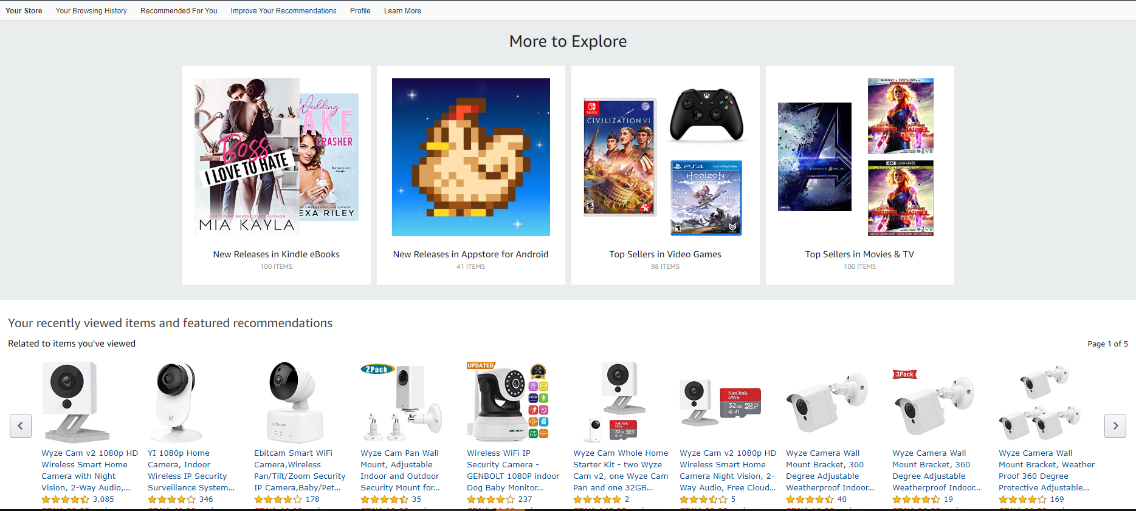
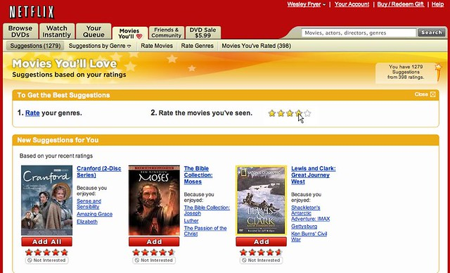
PROJECT OVERVIEWOVERVIEW
Recommender systems are algorithms designed to help users discover movies, products, and songs by predicting the user’s rating of each item and displaying similar items that they might rate high as well.
The objective is to show customers content that they would like best based on their historical activity.

Slide 3
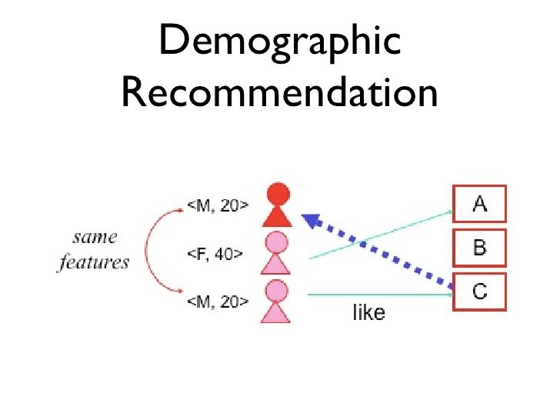
RECOMRECOMMENDER SYSTEMS: DEMOGRAPHIC FILTERING
They offer generalized recommendations to every user, based on movie popularity and/or genre. The System recommends the same movies to users with similar demographic features. Since each user is different , this approach is considered to be too simple. The basic idea behind this system is that movies that are more popular and critically acclaimed will have a higher probability of being liked by the average audience.

Slide 4
Demographic Filtering
Before getting started with this -
we need a metric to score or rate movie
Calculate the score for every movie
Sort the scores and recommend the best rated movie to the users.
We can use the average ratings of the movie as the score but using this won't be fair enough since a movie with 8.9 average rating and only 3 votes cannot be considered better than the movie with 7.8 as average rating but 40 votes. So, I'll be using IMDB's weighted rating (WR) which is given as :-
Weighted Rating(WR) = (v/v + m)*R + (m/v + m)*C
where,
v is the number of votes for the movie;
m is the minimum votes required to be listed in the chart;
R is the average rating of the movie; And
C is the mean vote across the whole report

Slide 5



RECOMRECOMMENDER SYSTEMS: USER-BASED COLLABORATIVE FILTER
MENDER SYSTEMS: USER-BASED COLLABORATIVE FILTER
User-based collaborative filtering works by building a matrix of every piece of content that users bought or viewed.
Similarity scores are then calculated between users to find similar users to each others.
For similar users, content that have not been viewed or bought are recommended to users that haven’t seen them before.
SIMILAR USERS

Slide 6
RECOMMENDER SYSTEMS: USER-BASED COLLABORATIVE FILTER LIMITATIONS
More users than products, movies..etc so making the problem more complex (~8 billion people!)
Users taste change over time.
Let’s explore another strategy that overcomes the limitations of User-based collaborative filtering. This strategy is named item-based collaborative filtering.

Slide 7
RECOMMENDER SYSTEMS: ITEM-BASED COLLABORATIVE FILTERING
Item-based collaborative filters work by recommending elements based on relationship between items and not people.
The recommender system is now designed based on items (such as movies) and not users.
This reduces the complexity of the problem and overcomes the challenges of user-based collaborative filtering.
Unlike humans, movies, songs, and products features and tastes do not change over time.

Slide 8
RECOMMENDER SYSTEMS: ITEM-BASED COLLABORATIVE FILTERING
Based on User #1 and #2, they both watched and liked Titanic and a walk to remember.
Item-based collaborative filtering will correlate both movies together based on user #1 and #2 behaviour.
User #3 watched “Titanic” and did not watch a “Walk to remember”, so the recommender system will recommend it for him/her.
SIMILAR ITEMS

